Slide 1
This slide is hidden.
Insert the starting slides after this slide

Slide 2
Please Stand

Slide 3
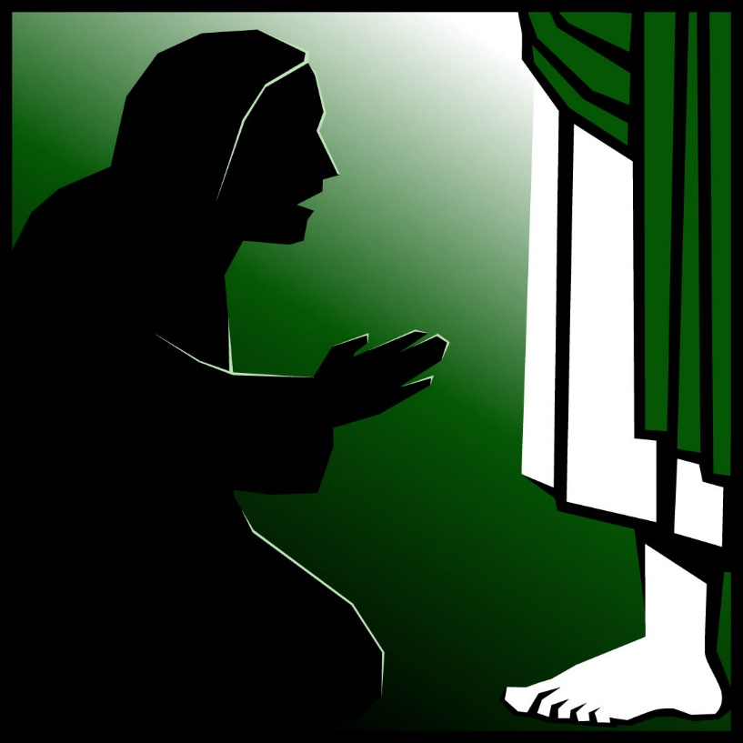
Welcome to St Michael’s
20th Sunday – Ordinary Time Year A
You have entered a
SACRED SPACE
– a SACRED TIME...
Please ensure all
mobile phones
are switched off.
Please be respectfully quiet
as we prepare for our celebration.
Notes:
Saturday 5.30PM First Sunday of Advent
- 20th Sunday in Ord Time
- 20th Sunday in Ord Time

Slide 4
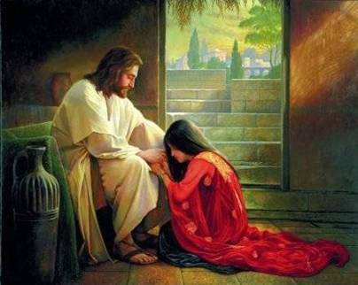
A woman had come up and was kneeling at Jesus’ feet. ‘Lord,’ she said ‘help me, my daughter is sick’.
Notes:
- 20th Sunday in Ord Time
- 20th Sunday in Ord Time

Slide 5
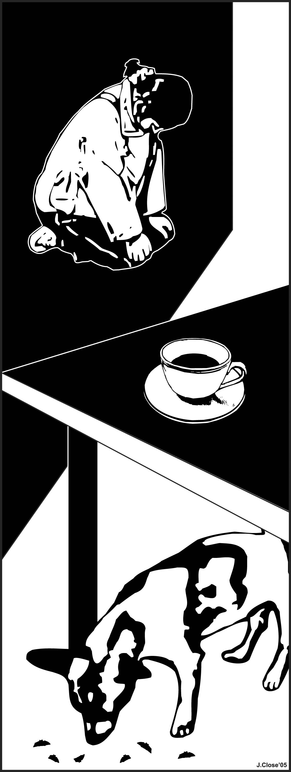
Jesus said “It is not fair to take the children’s food and throw it to the house-dogs.”
The woman replied “…Even
house-dogs can eat the scraps that fall from their master’s table.”
Notes:
- 20th Sunday in Ord Time
- 20th Sunday in Ord Time

Slide 6
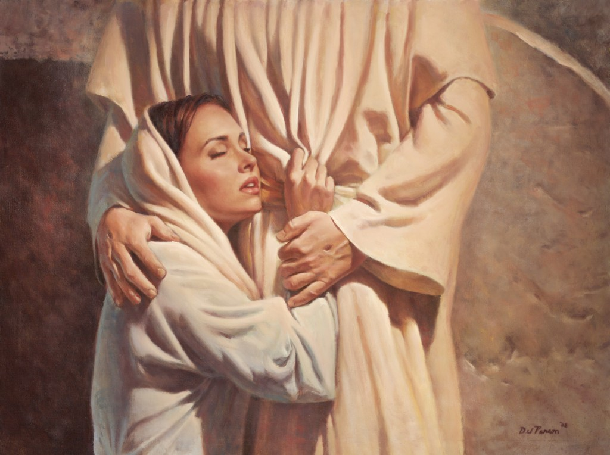
Then Jesus answered her, ‘Woman, you have great faith.’ And from that moment her daughter was well again.

Slide 7
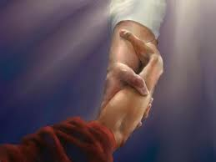
Who has helped you grow closer to God through an invitation or challenge?
Notes:
- 20th Sunday in Ord Time
- 20th Sunday in Ord Time

Slide 8
This slide is hidden.
Insert the Entrance Hymn after this slide

Slide 9
Praise the name of Jesus
Praise the name of Jesus
Praise him as we pray
Praise the name of Jesus
Sing to him all our days

Slide 10
From the rising of the sun
To the setting of the same
The name of the Lord is to be praised
In all things let's praise his name

Slide 11
Praise the name of Jesus
Praise him as we pray
Praise the name of Jesus
Sing ot him all our days

Slide 12
Let us come unto the Lord
Let us make a joyful noise
He has healed us through his word
In all things let's praise his name

Slide 13
Praise the name of Jesus
Praise him as we pray
Praise the name of Jesus
Sing to him all our days
Sing to him all our days

Slide 15
Confiteor
I confess to almighty God
And to you, my brothers and sisters,
That I have greatly sinned
In my thoughts and in my words

Slide 16
In what I have done
And in what I have failed to do,
Through my fault,
Through my fault,
Through my most grievous fault;

Slide 17
Therefore I ask blessed Mary ever-Virgin,
All the Angels and Saints,
And you, my brothers and sisters,
To pray for me to the Lord our God.

Slide 19
Kyrie eleison
Kyrie eleison (2)
Christe eleison (2)
Kyrie eleison (2)

Slide 21
Gloria
Glory to God in the highest,
and on earth peace to people of good will.
We praise you, we bless you,
we adore you, we glorify you,

Slide 22
We give you thanks for your great glory,
Lord, God heavenly king,
O God, almighty father

Slide 23
Glory to God in the highest,
and on earth peace to people of good will.

Slide 24
Lord Jesus Christ, Only Begotten Son,
Lord God, Lamb of God, Son of the Father,
you take away the sins of the world,
have mercy on us;

Slide 25
you take away the sins of the world, receive our prayer;
you are seated at the right hand of the Father,
have mercy on us.

Slide 26
Glory to God in the highest,
and on earth peace to people of good will.

Slide 27
For you alone are the Holy One,
you alone are the Lord,
you alone are the Most High, Jesus Christ,
with the Holy Spirit,
in the glory of God the Father.

Slide 28
Glory to God in the highest,
and on earth peace to people of good will.
Amen.

Slide 30
Responsorial Psalm
O God, let all the nations praise you!

Slide 32
Alleluia
Alleluia, alleluia,
alleluia, alleluia

Slide 34
Apostles Creed
I believe in God,
the Father almighty,
Creator of heaven and earth,
and in Jesus Christ, his only Son, our Lord,
(At the words that follow, up to and including the Virgin Mary, all bow.)

Slide 35
who was conceived by the Holy Spirit,
born of the Virgin Mary,
suffered under Pontius Pilate,
was crucified, died and was buried;
he descended into hell;

Slide 36
on the third day he rose again from the dead;
he ascended into heaven,
and is seated at the right hand of God the Father almighty;

Slide 37
from there he will come to judge the living and the dead.
I believe in the Holy Spirit,
the holy catholic Church,

Slide 38
the communion of saints,
the forgiveness of sins,
the resurrection of the body,
and life everlasting.
Amen.

Slide 40
First Collection
This collection goes to the Bishop
for the support of the Diocese.
Thank you for your contribution

Slide 42
This slide is hidden.
Insert the Offertory Hymn after this slide.

Slide 43
Blessed be God
Blest are you Lord, God of all creation
Thanks to your goodness
This bread we offer
Fruit of the earth, work of our hands
It will become the bread of life

Slide 44
Blessed be God, blessed be God
Blessed be God forever, amen
Blessed be God, blessed be God
Blessed be God forever, amen

Slide 45
Blest are you Lord God or all creation
Thanks to your goodness
This wine we offer
Fruit of the vine, work of our hands
It will become the cup of joy

Slide 46
Blessed be God, blessed be God
Blessed be God forever, amen
Blessed be God, blessed be God
Blessed be God forever, amen

Slide 48
Priest: Pray my brothers and sisters,
that my sacrifice and yours may be
acceptable to God, the almighty Father.
All: May the Lord accept the sacrifice
at your hands for the praise and glory of his name, for our good and the good of all his holy Church.

Slide 49
Priest: The Lord be with you.
All: And with your spirit.
Priest: Lift up your hearts.
All: We lift them up to the Lord.

Slide 50
Priest: Let us give thanks to the
Lord our God.
All: It is right and just.

Slide 52
Holy
Holy, Holy, Holy Lord God of hosts,
Heaven and earth are full of your glory. Hosanna in the highest
Blessed is he who comes
in the name of Lord,
Hosanna in the highest.

Slide 54
Memorial acclamation
Save us saviour of the world,
For by your cross and resurrection,
You have set us free

Slide 55
Memorial acclamation
When we eat this bread
And drink this cup
We proclaim your death O Lord
Until you come again

Slide 56
Memorial acclamation
We proclaim your death O Lord
And profess your resurrection
Until you come again

Slide 58
Amen
Amen, amen, amen, amen.
Amen, amen, amen, amen.

Slide 60
Priest: The Lord be with you.
All: And with your spirit

Slide 62
Peace
May the peace of the Lord be with you
With your friends and your family too
Let it be, let it grow
And everywhere you go
May the peace of the Lord follow you

Slide 63
Lamb of God
Lamb of God, lamb of God
You take away the sins of the world
Have mercy on us, lamb of God

Slide 64
Lamb of God, lamb of God
You take away the sins of the world
Have mercy on us, lamb of God

Slide 65
Lamb of God, lamb of God
You take away the sins of the world
Grant us, grant us peace

Slide 67
Priest: Behold the Lamb of God, behold him
who takes away the sins of the world.
Blessed are those called to the supper of the Lamb.
All: Lord, I am not worthy
that you should enter under my roof,
but only say the word
and my soul shall be healed.

Slide 68
This slide is hidden.
Insert the Communion Hymns after this slide.

Slide 69
In love for me
This is my body broken for you
Bringing you wholeness making you free
Take it and eat it, and when you do
Do it in love for me

Slide 70
This is my blood poured out for you
Bringing forgiveness, making you free
Take it and drink it, and when you do
Do it in love for me

Slide 71
This is my body broken for you
Bringing you wholeness making you free
Take it and eat it, and when you do
Do it in love for me

Slide 72
This is my blood poured out for you
Bringing forgiveness, making you free
Take it and drink it, and when you do
Do it in love for me
Do it in love for me

Slide 73
Hail Mary
Hail Mary full of grace,
The lord is with thee,
Blessed are you among women
And blest is the fruit of your womb,
Jesus. (Jesus)

Slide 74
Holy Mary, mother of God
Prayer for us sinner now, and at the hour of our death,
Amen. (Amen)

Slide 75
Gentle woman, quiet light,
Morning star so strong and bright
Gentle Mother, peaceful dove,
Teach us wisdom, teach us love.

Slide 76
You were chosen by the Father;
You were chosen for the Son.
You were chosen from all women
And for woman, shining one.

Slide 77
Gentle woman, quiet light,
Morning star so strong and bright
Gentle Mother, peaceful dove,
Teach us wisdom, teach us love.

Slide 78
Blessed are you among women
Blest in turn, all women too
Blessed they with peaceful spirits
Blessed they with gentle hearts

Slide 79
Gentle woman, quiet light,
Morning star so strong and bright
Gentle Mother, peaceful dove,
Teach us wisdom, teach us love.

Slide 81
Second Collection
What you contribute now
is for the support of our
parish and its mission.
Thank you for your generosity

Slide 82
This slide is hidden.
Insert the Notices for the week after this slide

Slide 83

SVDP PANTRY
Pasta Sauce
Long-life Milk
Biscuits
2-Minute Noodles
Sturdy supermarket carry bags for packing of food parcels.
Thank you for your generosity!

Slide 84

Music Workshop
All parish choirs are reminded of a Music
Workshop on Sunday 14 September.
Please keep this date free.

Slide 85

Christian Manhood
St Michael’s Parish Centre,
September 19,
6.30pm
for a 7pm start.

Slide 86
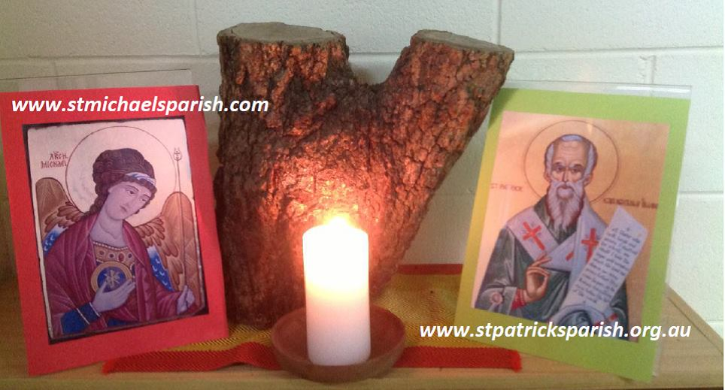
Please take home your bulletin or download it
www.stmichaelsparish.com
Visit us on Facebook
www.facebook.com/blacktowncatholics

Slide 87
This slide is hidden.
The next slide can be used for videos.
Insert the video into the slide.

Slide 89
Priest: The Lord be with you.
All: And with your spirit.

Slide 91
This slide is hidden.
Insert the Recessional Hymns after this slide.

Slide 92
Our Lady of the Southern Cross
You said your ‘yes’ to the angel’s word
The spirit of God was with you
You walked with jesus throughout his life,
With a mother’s care and trust

Slide 93
You stood at last beneath the cross
A model of courage and strength
Teach us to hope,
to believe and love like you,
Our lady of the southern cross.

Slide 94
Shine upon us,
Guide us through life,
Show us the way to Christ your son
Shine upon us guide us through life,
Mother of Jesus mother of Christ.

Slide 95
You sat and prayed with his closest friends
Awaiting the spirit to come.
You saw them change as they went transformed
To a world they hardly knew.

Slide 96
Now stand with us, O mother of light,
As we speak God’s love and truth
Teach us to hope,
to believe and love like you,
Our lady of the southern cross.

Slide 97
Shine upon us,
Guide us through life,
Show us the way to Christ your son
Shine upon us guide us through life,
Mother of Jesus mother of Christ

Slide 98
This slide is hidden.
Insert the final slide here.

